Slide 1
Regulation (EU) 2023/1115 on commodities and products associated with deforestation and forest degradation
EUDR
25 June 2024
European Commission

Slide 2
EU Deforestation Regulation - Context
420 million hectares of forest worldwide – an area larger than the EU – have been lost between 1990 and 2020 (FAO).
A significant share of that forest loss is legal (Forest Trends.)
Deforestation and forest degradation are important drivers of climate change (IPCC: 11% of GHG emissions) and biodiversity loss
90% of deforestation is provoked by the expansion of agricultural land (FAO), which is linked in particular to a series of commodities.
The EU is a major consumer of commodities associated with deforestation and forest degradation.

Slide 3
Regulation (EU) 2023/1115
Timeline
Provisional agreement of the co-legislator: 6 December 2023
Published in the Official Journal of the EU: 9 June 2023
Entered into force on 29 June 2023
Entry into application: 30 December 2024
Entry into application for small and micro-undertakings: 30 June 2025

Slide 4
Main elements [1]
Mandatory due diligence rules for all operators that place the relevant products on the EU market or export them from the EU
  Only products that are both deforestation-free and legal would be allowed on or exported from the EU market – need to be covered by a due diligence statement
  Based on internationally-backed definitions (FAO)
  Main obligations applicable to operators and non-SME traders
  Strict traceability linking the commodity to the plot of land where it was produced
  Legality: Products will need to be legal according to the laws of country of production, including applicable human and labour rights and free, prior and informed consent

Slide 5
Main elements [2]
Commodities selected: Palm oil, soy, wood, cattle, cocoa, coffee, rubber and some derived products (e.g. chocolate, furniture, tyres, printed products)
Non-discrimination: The Regulation applies both to domestically produced and imported commodities and derived products
Progressive scope - Initially covering selected commodities and derived products; to be updated regularly
‘Cut-off date’ of 31 December 2020: Aligned with UNSDG 15.2, aims to minimise disruption for smallholders and facilitate satellite monitoring

Slide 6
Main elements [3]
Benchmarking system that will assign risk to countries or regions according to risk of deforestation – standard (by default), low and high
Specific obligations for operators – simplified due diligence for low-risk (still required to collect information, but not assess and mitigate risks)
Minimum level of inspections for Member States authorities to perform (9%, 3% and 1%, depending on the level of risk)
Review: Other wooded land (one year); other ecosystems, commodities, products and financial institutions (two years); others (five years)

Slide 7
Deforestation free
Deforestation: Conversion of forests for agricultural use, whether human-induced or not.
Forest degradation = structural changes to forest cover, taking the form of the conversion of:
    primary forests or naturally regenerating forests -> plantation forests or into other wooded land; or
    primary forests -> planted forests;
Deforestation-free:
(A) has not been subject to deforestation after 31 December 2020.
(B) The wood has been harvested from the forest without inducing forest degradation after 31 December 2020

Slide 8
Focus on Implementation
Clarifying operational questions via the Frequently Asked Questions
Work on Guidance Document on technical legal matters
Setting up of the IT System
Strengthening support tools to Producer Countries
Other strands: deforestation observatory, risk benchmarking etc.
8
8

Slide 9
Frequently Asked Questions
Key aspects of implementation for operators/traders and for competent authorities
First published in June 2023
Over 80 Q/A
Latest update in Dec 2023
9

Slide 10


Guidance Document
In the pipeline: aiming to publish in Summer
Selected thematic areas, such as:
Definition of agricultural use
Legality
Composite products
Certification
Due diligence
10

Slide 11

Information System
Pilot testing, over 100 companies participated (December 2023 –January 2024)
Summer: more information to come
Autumn: Dedicated trainings
Beginning of November: Opening user registration for the system
Beginning of December: Opening system for submitting Due Diligence Statements
Interconnection with other systems via Application Programming Interface
11

Slide 12
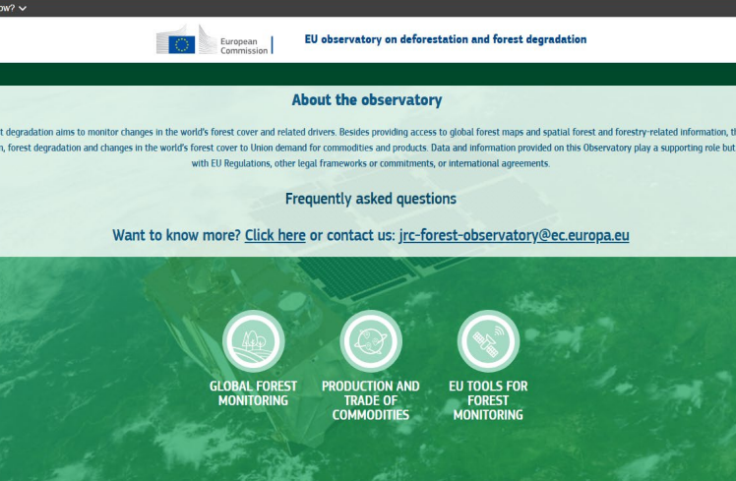
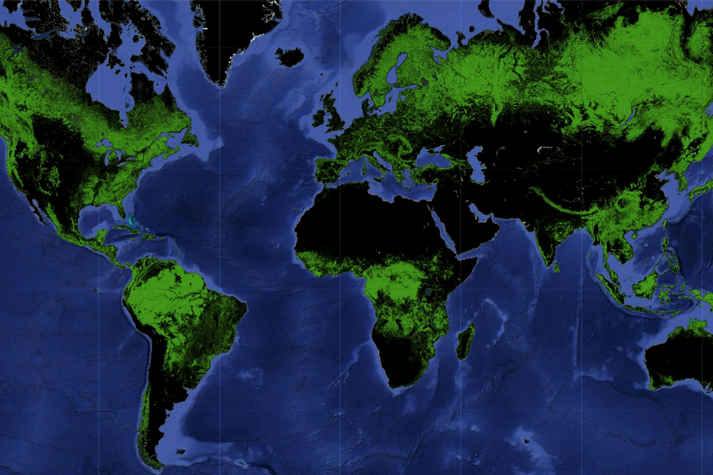
EU Observatory on Deforestation
developed by JRC, to provide a.o. reference maps on global forest cover
presented in Dec 2023, and currently publicly accessible online
Third countries to provide comments and feedback
12

Slide 13



Cooperation with third countries
Cooperation with both producing and consumer countries
→ Engagement with other major consumer countries such as China and the USA
Political dialogue, public diplomacy and technical assistance
→ Active outreach to stakeholders through Commission, EU Delegations, EU Member States; dedicated outreach project starting to enhance understanding in Southeast Asia and Latin America of the EU Regulation
→ Enhanced cooperation to address potential challenges in producer countries
→ Regular briefings in multilateral fora (WTO, FAO etc.)
The role of the Deforestation Multi-stakeholders Platform
→ All interested producer and consumer countries invited, all key sectorial associations and civil society organisations represented
→ Work on implementation; specific focus: traceability and smallholders; sharing of best practices, cooperation initiatives
13

Slide 14
Trade with Türkiye
Quantity of EU27 imports of all focal commodities | Commodities quantity (% of all focal commodities imported from the country) | Commodities value (million EUR)
1 261 million kg | Timber (70.4%); Rubber (26.9%); Cocoa (1.1%); Palm oil (0.8%); Beef (0.5%); Soy (0.3%); Coffee (<0.1%) | Timber (1 764); Rubber (1 466); Beef (61); Cocoa (53); Palm oil (16); Coffee (3); Soy (3)
14

Slide 15

Thank you!
Learn more here: https://environment.ec.europa.eu/topics/forests/deforestation/regulation-deforestation-free-products_en https://green-business.ec.europa.eu/deforestation-regulation-implementation_en
© European Union 2021
Unless otherwise noted the reuse of this presentation is authorised under the CC BY 4.0 license. For any use or reproduction of elements that are not owned by the EU, permission may need to be sought directly from the respective right holders.

